Slide 1
Express from
the inside
NODE.JS · EXPRESS 5
What req carries, what res sends back, and how middleware sits in between.
req
logger
auth
route
res
Notes:
Open with the one picture students should carry all session: a request goes in, passes through a chain of functions (middleware), and exactly one response comes back. Everything today is a zoom-in on one part of this chain.

Slide 2
From one request to a full pipeline
TODAY’S ROUTE
01
02
03
Your server.js
req
res
Every line, with the browser and the console side by side.
Everything the request carries: params, query, headers, ip, body.
Every way to answer: text, HTML, JSON, files, redirects, status codes.
04
05
06
Practice + quiz
Middleware
One pipeline
Six graded sets on the Fake Store API, then MCQ and MSQ checks.
Why it exists, then all five types, small examples first.
All five types working together in one app, then the final quiz.
Notes:
Set expectations: first we understand the objects (req, res), then we practise on real product data, and only then do we bring in middleware, which is just more functions that receive the same req and res.

Slide 3
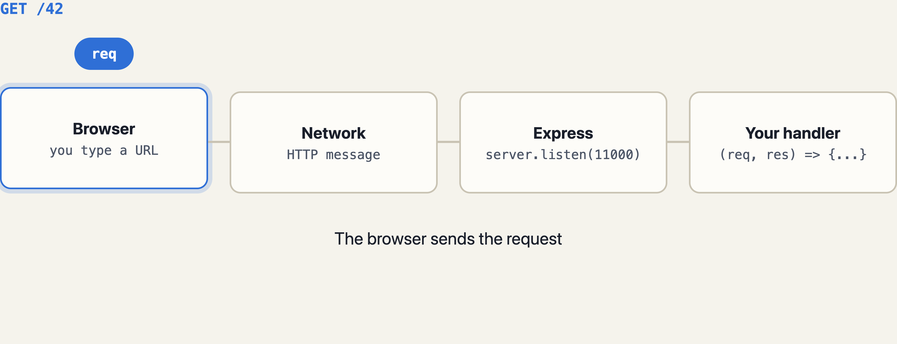
One request in, exactly one response out
THE REQUEST–RESPONSE CYCLE
Notes:
Let this loop twice. Key points: (1) req and res are created fresh for every request and thrown away after; (2) your handler must answer exactly once; (3) the browser only ever sees what res sends. Everything else stays on the server.

Slide 4
Your server.js,
line by line
PART 1
Code on the left. Predict the output first. Then click to reveal what the browser shows and what the server console prints.
Notes:
Make "predict, then reveal" the habit. On each split slide the browser and console panels appear on click, so pause and ask the class what they expect first.

Slide 5
Five parts in one small file
SERVER.JS · THE WHOLE FILE
// 1 · setup
const express = require('express');
const fs = require('fs');
const server = express();
const data = fs.readFileSync('./index.html','utf-8');
// 2 · a middleware function
const middleware1 = (req, res, next) => {
var login = true;
if (login) {
console.log("User has loggedIN......");
next();
} else {
res.send("Kindly Login");
}
};
// 3 · application-level middleware
server.use('/', middleware1);
// 4 · routes (API endpoints)
server.get('/', (req, res) => {
res.send(data);
});
server.get('/:id', (req, res) => {
res.send(`Testing...for id: ${req.params.id}`);
});
server.post('/', (req, res) => {
res.send("Data posted");
});
server.put('/', (req, res) => {
res.send("Data updated");
});
// 5 · start listening
server.listen(11000, () => {
console.log("Server running on port 11000");
});
Notes:
This is the class code, unchanged except for spacing. Read the five comments aloud: setup, a middleware function, registering it, the routes, and listen. The next slides take each part and show what actually appears in the browser and in the terminal.

Slide 6
What happens on node server.js
PARTS 1 & 5 · SETUP AND LISTEN
server.js
GOOD TO KNOW
const express = require('express');
// a function that builds an app
const server = express();
// server has .use .get .post .put .listen
const data = fs.readFileSync('./index.html',
'utf-8');
// runs ONCE, at startup → data is a string
server.listen(11000, () => {
console.log("Server running on port 11000");
});
// opens port 11000 and waits for requests
Edited index.html? Restart the server. The file was read once into data, not on every request.
No routes run yet. They run only when a request arrives.
SERVER CONSOLE
$ node server.js
Server running on port 11000
▌ (keeps running, waiting…)
Notes:
Two misconceptions to kill early. First: the routes do not run at startup; Express just stores them. Second: readFileSync happened once, so the HTML is cached in memory. Change index.html and nothing changes until you restart (or use node --watch server.js).

Slide 7
GET / passes the check, then reaches the route
PARTS 2 & 3 · MIDDLEWARE1 WITH LOGIN = TRUE
server.js
localhost:11000
const middleware1 = (req, res, next) => {
var login = true;
if (login) {
console.log("User has loggedIN......");
next(); // go on to the route
} else {
res.send("Kindly Login");
}
};
server.use('/', middleware1); // every path
server.get('/', (req, res) => {
res.send(data);
});
Welcome!
Your index.html, rendered as a page (because res.send(string) sends Content-Type text/html).
SERVER CONSOLE
Server running on port 11000
User has loggedIN......
User has loggedIN......
Twice? The browser also asked for /favicon.ico. Two slides ahead.
Notes:
Walk the order: request arrives, middleware1 runs first because it was registered first, prints, calls next(), and only then does server.get('/') run and send. The second log line is the browser silently requesting /favicon.ico. Let students spot it before you explain.

Slide 8
The middleware answers, so no route runs
PARTS 2 & 3 · MIDDLEWARE1 WITH LOGIN = FALSE
server.js
localhost:11000/42
const middleware1 = (req, res, next) => {
var login = false; // changed
if (login) {
console.log("User has loggedIN......");
next();
} else {
res.send("Kindly Login"); // ends here
}
};
server.use('/', middleware1);
// none of these run now:
// GET / GET /:id POST / PUT /
Kindly Login
Same text for /, /42, /anything, and for POST and PUT too.
SERVER CONSOLE
Server running on port 11000
(nothing new: the log line is
inside the if, which did not run)
Notes:
A middleware has two choices: call next() to pass the request on, or send a response itself. Here it sends "Kindly Login", so the cycle ends and Express never looks at the routes. Because it is mounted on "/", it guards every path and every method.

Slide 9
:id catches whatever sits in that slot
PART 4 · A ROUTE PARAMETER
server.js
localhost:11000/42
server.get('/:id', (req, res) => {
console.log(req.params);
console.log(req.params.id);
console.log(typeof req.params.id);
console.log(req.ip);
res.send(`Testing...for id: ${req.params.id}`);
});
// /42 → id = '42'
// /about → id = 'about'
// /a/b → no match (two segments)
Testing...for id: 42
SERVER CONSOLE
User has loggedIN......
{ id: '42' }
42
string
::1
::1 is “localhost” in IPv6. Params are always strings.
Notes:
Uncomment the console.log lines from the class file and run. Points: req.params is an object; the key name comes from the route (:id gives id); the value is always a string, so '42' + 1 is '421'. req.ip on your own machine is ::1 (IPv6 loopback) or ::ffff:127.0.0.1.

Slide 10
You opened one page. The browser asked twice.
GOTCHA · THE HIDDEN SECOND REQUEST
DEVTOOLS › NETWORK (F12)
SERVER CONSOLE
Name | Status | Type
localhost | 200 | document
favicon.ico | 200 | text/html
User has loggedIN......
User has loggedIN......
{ id: 'favicon.ico' }
The browser fetches /favicon.ico on its own to get the tab icon. That path has one segment, so it matches '/:id' with id = 'favicon.ico'.
ONE FIX: ANSWER IT FIRST
server.get('/favicon.ico',
(req, res) => res.sendStatus(204));
// put it ABOVE '/:id'
Routes are checked top to bottom. First match wins.
Notes:
This is the best moment to open DevTools for the first time. Show the Network tab, reload, and point at the second row. 204 means "No Content": a valid answer with an empty body. The lesson that matters later: Express checks routes in the order you wrote them.

Slide 11
The address bar can only send GET
PART 4 · POST AND PUT
server.js
THUNDER CLIENT / POSTMAN
server.post('/', (req, res) => {
res.send("Data posted");
});
server.put('/', (req, res) => {
res.send("Data updated");
});
// Test with Thunder Client (VS Code),
// Postman, or curl in a terminal.
// Windows PowerShell: type curl.exe
POST
http://localhost:11000/
Status: 200 OK
Data posted
TERMINAL (CLIENT SIDE)
$ curl -X POST localhost:11000/
Data posted
$ curl -X PUT localhost:11000/
Data updated
$ curl -X DELETE localhost:11000/
…<pre>Cannot DELETE /</pre>…
Notes:
Typing a URL and pressing Enter always sends GET. To send POST, PUT or DELETE you need a client: Thunder Client inside VS Code is the quickest for class. The DELETE line shows Express’s built-in 404 page, because no route handles DELETE on "/".

Slide 12
Which code answers each request?
PREDICT, THEN CLICK · LOGIN = TRUE
Request | Handled by | Response
GET / | get('/') | index.html page
GET /42 | get('/:id') | Testing...for id: 42
GET /about | get('/:id') | Testing...for id: about
GET /a/b | nobody | 404 Cannot GET /a/b
POST / | post('/') | Data posted
POST /42 | nobody | 404 Cannot POST /42
PUT / | put('/') | Data updated
DELETE / | nobody | 404 Cannot DELETE /
Predict both columns, then click
middleware1 prints User has loggedIN...... for all eight, even the 404s: it runs before Express knows no route will match.
Notes:
Ask students to call out answers row by row before revealing. Common mistakes: thinking /about gives a 404 (it matches :id), and thinking POST /42 goes to the :id route (that route is GET only). Last point: middleware mounted on "/" runs for every request, matched or not.

Slide 13
req: what the
request carries
PART 2
Every piece of the URL, every header, the caller’s address and the body, already parsed for you by Express.
Notes:
Frame req as a parcel that arrives at the server with labels already filled in. Our job is just to know which label to read.

Slide 14

Express splits the URL into labelled pieces
ANATOMY OF ONE REQUEST
route: server.get('/products/:id', handler)
req.method
'GET'
req.params.id
'7'
http://localhost:11000/products/7?sort=desc&limit=3
req.protocol
'http'
req.hostname
'localhost'
req.path
'/products/7'
req.query
{ sort: 'desc', limit: '3' }
req.originalUrl → '/products/7?sort=desc&limit=3'
req.get('host') → 'localhost:11000'
Every value is a string, even '7' and '3'.
Notes:
Click through the seven builds and ask what each label will hold before it appears. The coloured bars under the URL mark the pieces. Emphasise: params come from the route pattern (:id), query comes from after the ?, and every value is text.

Slide 15
Log it all, then send it back as JSON
REQ · METHOD, URL, PATH
server.js
localhost:11000/products/7?sort=desc
server.get('/products/:id', (req, res) => {
console.log('method ', req.method);
console.log('url ', req.url);
console.log('originalUrl', req.originalUrl);
console.log('path ', req.path);
console.log('hostname ', req.hostname);
console.log('protocol ', req.protocol);
res.json({
method: req.method,
path: req.path
});
});
{"method":"GET",
"path":"/products/7"}
SERVER CONSOLE
method GET
url /products/7?sort=desc
originalUrl /products/7?sort=desc
path /products/7
hostname localhost
protocol http
Notes:
req.url and req.originalUrl look identical here. They only differ inside a Router, where req.url loses the mount prefix: keep that in mind for the router section. req.path never includes the query string.

Slide 16
Each :name in the route becomes a key
REQ.PARAMS · MORE THAN ONE
server.js
localhost:11000/products/7/reviews/3
server.get(
'/products/:id/reviews/:reviewId',
(req, res) => {
console.log(req.params);
console.log(req.params.id + 1);
const id = Number(req.params.id);
console.log(id + 1);
res.json(req.params);
}
);
{"id":"7","reviewId":"3"}
SERVER CONSOLE
{ id: '7', reviewId: '3' }
71
8
'7' + 1 joins text. Convert with Number() before doing maths or comparing with ===.
Notes:
The string trap shows up in every practice set: products.find(p => p.id === req.params.id) never matches, because 7 === '7' is false. Always Number() it first.

Slide 17
Optional filters, no route change needed
REQ.QUERY · EVERYTHING AFTER ?
server.js
…/products?category=jewelery&limit=2
server.get('/products', (req, res) => {
console.log(req.query);
const { category, limit } = req.query;
console.log(category, limit, typeof limit);
console.log(req.query.sort); // not sent
res.send(
`category=${category}, limit=${limit}`
);
});
// params → which thing (/products/7)
// query → how to filter it (?limit=2)
category=jewelery, limit=2
SERVER CONSOLE
{ category: 'jewelery', limit: '2' }
jewelery 2 string
undefined
Missing keys are undefined, not errors. Values are strings again.
Notes:
Order of query keys does not matter, and the same route serves /products, /products?limit=2 and /products?category=jewelery. Note the API’s own spelling: the category is "jewelery".

Slide 18
Who is asking, and from where
REQ.HEADERS, REQ.GET(), REQ.IP
server.js
localhost:11000/whoami
server.get('/whoami', (req, res) => {
console.log(req.ip);
console.log(req.get('User-Agent'));
console.log(req.headers.host);
console.log(req.headers['accept-language']);
console.log(req.secure);
res.json({
ip: req.ip,
browser: req.get('User-Agent')
});
});
// req.get() ignores case; req.headers keys
// are always lowercase
{"ip":"::1","browser":"Mozilla/5.0 (Windows NT 10.0; Win64; x64) AppleWebKit/537.36 …"}
SERVER CONSOLE
::1
Mozilla/5.0 (Windows NT 10.0; …
localhost:11000
en-IN,en;q=0.9
false
Open it from a phone on the same Wi-Fi and req.ip changes.
Notes:
Headers are the envelope of a request: browser type, language, cookies, auth tokens. Open /whoami in Chrome, then Firefox, then from Thunder Client and compare the User-Agent. req.secure is true only over HTTPS.

Slide 19
req.body is empty until something reads it
REQ.BODY · DATA SENT WITH POST OR PUT
server.js
POST
localhost:11000/products
server.use(express.json());
// ↑ this one line fills req.body
server.post('/products', (req, res) => {
console.log(req.body);
console.log(req.body.title, req.body.price);
res.status(201).json({
id: 21,
...req.body
});
});
Body (JSON): {"title":"Steel Bottle","price":12.5}
Status: 201 Created
{"id":21,"title":"Steel Bottle","price":12.5}
SERVER CONSOLE
{ title: 'Steel Bottle', price: 12.5 }
Steel Bottle 12.5
Remove express.json() and req.body is undefined, so req.body.title throws a TypeError.
Notes:
This is the first time middleware matters to students directly. express.json() reads the raw request body, parses it, and stores it on req.body. In Express 5 req.body stays undefined if no parser ran. JSON keeps types: price is the number 12.5, unlike params and query.

Slide 20
GET /products/7?sort=desc on route /products/:id
CHEAT SHEET · REQ
Property | Value
req.method | 'GET'
req.params | { id: '7' }
req.query | { sort: 'desc' }
req.path | '/products/7'
req.originalUrl | '/products/7?sort=desc'
req.hostname | 'localhost'
req.protocol | 'http'
Property | Value
req.ip | '::1'
req.get('User-Agent') | 'Mozilla/5.0 …'
req.headers | all headers, lowercase keys
req.baseUrl | '' (or '/api' inside a router)
req.url | prefix removed inside a router
req.body | undefined until express.json()
req.cookies | undefined until cookie-parser
Rule of thumb: URL pieces are always strings; only a parsed JSON body keeps numbers and booleans.
Notes:
A one-slide reference to screenshot. The last three rows connect forward: baseUrl and url matter once we use Router, and body and cookies are filled in by middleware.

Slide 21
res: everything you
can send back
PART 3
Text, HTML, JSON, files, downloads, redirects, status codes, headers and cookies. One answer per request.
Notes:
req is read-only information; res is your toolbox for replying. The single rule that governs all of it is on the next slide.

Slide 22
Answer exactly once. Use return to stop.
THE ONE RULE OF RES
server.js · a very common bug
localhost:11000/products/99
server.get('/products/:id', (req, res) => {
const p = products.find(
x => x.id === Number(req.params.id));
if (!p) {
res.status(404).send('Not found');
// no return → code keeps going
}
res.json(p); // second answer!
});
// fix:
if (!p) return res.status(404).send('Not found');
Not found
The browser got the first answer. The second one crashed on the server.
SERVER CONSOLE
Error [ERR_HTTP_HEADERS_SENT]: Cannot set headers after they are sent to the client
at ServerResponse.setHeader …
Notes:
Every student hits ERR_HTTP_HEADERS_SENT within a week. Translate it for them: "you tried to answer twice". The fix is almost always a missing return before an early res.send / res.json.

Slide 23
send() looks at what you give it
RES.SEND() · PREDICT, THEN CLICK
You write | Browser shows | Content-Type
res.send('Hello') | Hello | text/html
res.send('<h1>Hi</h1>') | Hi, as a big heading | text/html
res.send({ id: 1 }) | {"id":1} | application/json
res.send([1, 2]) | [1,2] | application/json
res.send(Buffer.from('hi')) | a file download | application/octet-stream
What will the browser show?
String → HTML
Object or array → JSON
Your teacher-code index.html renders because of this.
send() hands it to res.json() for you.
Notes:
Ask: why did res.send(data) in the class code render a web page instead of showing raw tags? Because a string is sent as text/html, so the browser renders it. Objects and arrays become JSON automatically.

Slide 24
Data plus a status code that tells the truth
RES.JSON(), RES.STATUS(), RES.SENDSTATUS()
server.js
localhost:11000/api/products/99
server.get('/api/products/:id', (req, res) => {
const p = products.find(
x => x.id === Number(req.params.id));
if (!p) {
return res.status(404)
.json({ error: 'Product not found' });
}
res.json(p); // status 200 by default
});
server.delete('/api/products/:id',
(req, res) => res.sendStatus(204));
// status() alone sends nothing: chain it!
{"error":"Product not found"}
Network tab: 404 Not Found
STATUS CODES YOU WILL USE
200 OK | 201 Created
204 No Content | 400 Bad Request
401 Unauthorized | 404 Not Found
500 Server Error | 302 Redirect
sendStatus(401) sends the word “Unauthorized” as the body.
Notes:
Three tools: res.json(data) for data, res.status(code) to set the code (it does not send), and res.sendStatus(code) to send only a code. Status codes are how programs, not people, know whether a request worked.

Slide 25
Send a file without reading it yourself
RES.SENDFILE()
server.js
WHY IT’S BETTER
// before: read once, send the string
// const data = fs.readFileSync(...)
const path = require('path');
server.get('/', (req, res) => {
res.sendFile(path.join(__dirname, 'index.html'));
});
// ✗ relative path
res.sendFile('index.html');
// ✓ or give a root
res.sendFile('index.html', { root: __dirname });
Reads the file on each request, so edits show on refresh.
Sets Content-Type from the extension: .html, .png, .pdf.
SERVER CONSOLE · THE ✗ LINE
TypeError: path must be absolute or specify root to res.sendFile
__dirname is the folder that holds server.js.
Notes:
This is the upgrade path for the class code: replace readFileSync plus res.send(data) with res.sendFile. Later, express.static will do this for a whole folder.

Slide 26
Send the browser elsewhere, or save a file
RES.REDIRECT() AND RES.DOWNLOAD()
server.js
/shop → localhost:11000/products
server.get('/shop', (req, res) => {
res.redirect('/products'); // 302
});
server.get('/old-products', (req, res) => {
res.redirect(301, '/products'); // moved
});
server.get('/products/:id/image', (req, res) => {
const p = findProduct(req.params.id);
res.redirect(p.image); // another site
});
server.get('/invoice', (req, res) => {
res.download(path.join(__dirname, 'invoice.pdf'));
});
You typed /shop. The address bar now says /products: the browser made a second request on its own.
DEVTOOLS › NETWORK
Name | Status | Note
shop | 302 | Location
products | 200 | page
invoice | 200 | saved
Notes:
A redirect is not the server fetching the page; it tells the browser "go ask over there", and the browser sends a new request. download() sends a file with Content-Disposition: attachment, so the browser saves it instead of showing it. Note: Express 5 removed res.redirect('back').

Slide 27
Labels on the envelope, before you seal it
RES.SET(), RES.TYPE(), RES.COOKIE(), RES.END()
server.js
RESPONSE HEADERS · /api/products
server.get('/api/products', (req, res) => {
res.set('X-Total-Count', String(products.length));
res.set('Cache-Control', 'no-store');
res.cookie('lastVisit', 'products');
res.json(products);
});
server.get('/plain', (req, res) => {
res.type('text').send('<h1>not rendered</h1>');
});
server.get('/logout', (req, res) => {
res.clearCookie('lastVisit').end();
});
HTTP/1.1 200 OK
X-Powered-By: Express
X-Total-Count: 20
Cache-Control: no-store
Set-Cookie: lastVisit=products; Path=/
Content-Type: application/json
localhost:11000/plain
<h1>not rendered</h1>
text/plain: the tags show as text.
Notes:
set, type and cookie only prepare the response; json, send or end actually send it. Compare /plain with res.send('<h1>…') from earlier: the same string renders or not depending only on the Content-Type header.

Slide 28
Prepare as much as you like, finish once
CHEAT SHEET · RES
Finishes the response (pick one)
Prepares it (chain, then finish)
Method | Sends
res.send(x) | text, HTML or JSON
res.json(obj) | JSON
res.sendStatus(404) | code + “Not Found”
res.sendFile(absPath) | a file to view
res.download(path) | a file to save
res.redirect('/x') | 302 + Location
res.end() | nothing more
res.render(view) | HTML from a template
Method | Sets
res.status(201) | status code
res.set(name, val) | any header
res.type('json') | Content-Type
res.cookie(name, val) | Set-Cookie
res.clearCookie(name) | expires a cookie
res.locals.x = … | data for this request
Notes:
The left column ends the cycle; use exactly one per request. The right column can be called any number of times before that and chained: res.status(201).set('X-Id','21').json(product). res.render needs a template engine such as EJS, outside today’s scope.

Slide 29
Old tutorials show v4 code. Spot the difference.
HEADS-UP · EXPRESS 5
Seen in old (v4) tutorials | Write this in Express 5
res.send(404) | res.sendStatus(404)
res.json(obj, 404) | res.status(404).json(obj)
res.redirect('back') | res.redirect(req.get('Referrer') || '/')
req.body is {} with no parser | req.body is undefined with no parser
app.get('*', …) | app.get('/*splat', …), or a final app.use for 404s
async errors need try/catch | a rejected promise reaches the error handler by itself
npm install express now installs version 5. Check yours with npm ls express.
Notes:
Students copy from blogs and Stack Overflow written for Express 4. These six differences cause most of the "it works in the video but not for me" moments. The async one comes back in the error-handling section.

Slide 30
Build your own
mini store API
PART 4 · PRACTICE
Real product data from fakestoreapi.com, six sets from easy to tricky. Every set says exactly what output to expect.
Notes:
Hand out the sets as lab work. Each one targets specific req and res features, so students can check themselves against the expected output.

Slide 31
20 products, one shape
THE DATA · FAKESTOREAPI.COM/PRODUCTS
category | ids | count
men's clothing | 1–4 | 4
jewelery | 5–8 | 4
electronics | 9–14 | 6
women's clothing | 15–20 | 6
one product (id 1)
{
"id": 1,
"title": "Fjallraven - Foldsack No. 1 Backp…",
"price": 109.95,
"description": "Your perfect pack for…",
"category": "men's clothing",
"image": "https://fakestoreapi.com/img/…png",
"rating": {
"rate": 3.9,
"count": 120
}
}
THE REAL API OFFERS
/products /products/1
/products?limit=5&sort=desc
/products/categories
/products/category/jewelery
Notes:
Open https://fakestoreapi.com/products in the browser first so students see the raw JSON. Note the nested rating object and the API’s own spelling "jewelery". Our sets rebuild these endpoints on our own server, so we control req and res.

Slide 32
Two ways to load the data
SETUP · GET THE 20 PRODUCTS INTO YOUR SERVER
A · Save a file (best for class)
B · Fetch at startup (Node 18+)
// open fakestoreapi.com/products,
// save it as products.json beside
// server.js
const products = require('./products.json');
console.log(`Loaded ${products.length}`);
// works offline, never rate-limited
let products = [];
fetch('https://fakestoreapi.com/products')
.then(r => r.json())
.then(data => {
products = data;
console.log(`Loaded ${data.length}`);
});
CONSOLE · A
CONSOLE · B (order flips!)
Loaded 20
Server running on port 11000
Server running on port 11000
Loaded 20
Notes:
Use A in class. B is a nice async lesson: fetch is asynchronous, so listen() finishes first and for a moment products is still an empty array. A request that arrives in that gap gets an empty list.

Slide 33
Find one product by id
SET 1 · REQ.PARAMS, RES.JSON, RES.STATUS · LEVEL 1
BUILD
EXPECTED OUTPUT
GET /products/:id → the product as JSON
Unknown id → status 404 and an error object
GET /products/:id/price → only id and price
GET /products/:id/rating → only the rating
Bonus: id that is not a number → 400
/products/5
{"id":5,"title":"John Hardy Women's…","price":695,…}
/products/99 404
{"error":"Product 99 not found"}
/products/5/price
{"id":5,"price":695}
/products/11/rating
{"rate":4.8,"count":319}
/products/abc 400
{"error":"id must be a number"}
Hint: Number(req.params.id), then products.find(p => p.id === id). Check Number.isNaN(id) for the bonus.
Notes:
Expected time: 15 minutes. Watch for the string-versus-number bug and the missing return before the 404. Order matters: /products/:id/price is a different route from /products/:id because it has three segments, so both can coexist.

Slide 34
One route, many filters
SET 2 · REQ.QUERY, RES.SET · LEVEL 2
Request (/products…) | ids returned
?category=electronics | 9–14 (6)
?maxPrice=20 | 4, 7, 8, 18, 19, 20
?limit=3 | 1, 2, 3
?sort=desc&limit=3 | 20, 19, 18
?category=jewelery&maxPrice=50 | 7, 8
?category=toys | [] (0)
BUILD · GET /products
?category=… keeps one category
?maxPrice=… keeps price ≤ that number
?sort=desc reverses the order
?limit=… keeps the first n
Any mix of them works together
Header X-Total-Count = items returned
Hint: start with let list = [...products], filter step by step, apply limit last. Query values are strings: Number(maxPrice).
Notes:
Expected time: 20 minutes. Discuss why limit must be applied last (otherwise ?limit=3&category=electronics returns nothing). Category names with spaces work in the browser: men's clothing becomes men's%20clothing and Express decodes it.

Slide 35
Categories, and the route that steals them
SET 3 · ROUTE ORDER · LEVEL 2
server.js · spot the bug
localhost:11000/products/categories
server.get('/products/:id', getOne);
server.get('/products/categories', (req, res) => {
const names = products.map(p => p.category);
res.json([...new Set(names)]);
});
server.get('/products/category/:name',
(req, res) => { /* filter by name */ });
// BUILD: both routes, then fix the order
{"error":"id must be a number"}
':id' matched first, with id = 'categories'.
AFTER MOVING /categories ABOVE /:id
/products/categories
["men's clothing","jewelery",
"electronics","women's clothing"]
/products/category/jewelery
ids 5, 6, 7, 8
Notes:
Let students hit the bug first. Rule: specific paths before parameter paths. /products/category/:name is safe either way because it has three segments and :id only matches two. new Set removes duplicates, keeping first-seen order.

Slide 36
Same data, five different answers
SET 4 · EVERY KIND OF RES · LEVEL 2
Route | Use | Expected
/products/:id/image | res.redirect | /products/3/image → the jacket photo opens; address bar is now fakestoreapi.com/img/…
/products/:id/title | res.type('text') | /products/3/title → Mens Cotton Jacket (plain text)
/products/:id/card | res.send(html) | title as a heading, the image 200px wide, the price below
/stats | res.json | {"count":20,"avgPrice":162.05, "cheapest":{"id":19,"price":7.95}, "costliest":{"id":14,"price":999.99}}
/download | res.download | products.json is saved by the browser
Hint: avgPrice = sum ÷ count, then Number(avg.toFixed(2)). For /card use a template string with ${p.title}, ${p.image}, ${p.price}.
Notes:
Expected time: 25 minutes. This set makes students choose the right res method for each job. Check /card renders HTML (not escaped text) and /title does not render tags. Sum of all prices is 3240.92.

Slide 37
Change the data, not just read it
SET 5 · REQ.BODY, POST, PUT, DELETE · LEVEL 3
BUILD (use Thunder Client)
EXPECTED OUTPUT
Add server.use(express.json())
POST /products → new id = highest id + 1, push it, reply 201
No title, or price not a number → 400
PUT /products/:id → update only the fields sent
DELETE /products/:id → 204, then GET gives 404
POST /products {"title":"Steel Bottle","price":12.5}
201 {"id":21,"title":"Steel Bottle","price":12.5}
POST /products {"price":"cheap"}
400 {"error":"title and price are required"}
PUT /products/21 {"price":9.99}
200 {"id":21,"title":"Steel Bottle","price":9.99}
DELETE /products/21
204 (empty body)
GET /products/21
404 {"error":"Product 21 not found"}
Hint: Object.assign(product, req.body) for PUT; products.splice(index, 1) for DELETE. Restart the server and all changes vanish: data lives in memory.
Notes:
Expected time: 30 minutes. Good discussion points: why 201 and 204; why validation returns 400 not 500; and that without a database, everything resets on restart. Spreading req.body directly into a product lets a client overwrite the id, so a strong student can protect it.

Slide 38
Think like an API designer
SET 6 · CHALLENGE · LEVEL 3
Request | Expected response
/products/top?n=3 | highest rating.rate first → ids 11, 12, 3
/search?q=JACKET | case-insensitive title match → ids 3, 15, 16, 17
/products/most-reviewed | id 17, Rain Jacket…, 679 reviews
/compare?a=1&b=5 | {"cheaper":1,"difference":585.05}
/compare?a=1 | 400 {"error":"a and b are required"}
GET /xyz (any unknown) | 404 {"error":"Route GET /xyz not found"}
Last row: put server.use((req, res) => …) after every route. It runs only when nothing matched.
That function is your first hand-written middleware. Keep it. We start the next part with it.
Notes:
Expected time: 40 minutes, for fast finishers or homework. /products/top and /products/most-reviewed must sit above /products/:id. For sorting use [...products].sort((a, b) => b.rating.rate - a.rating.rate) so the original array stays in id order. The 404 catch-all is a deliberate bridge into middleware.

Slide 39
Compare with yours after you try
REFERENCE SOLUTION · SETS 1 AND 2
Set 1 · one product
Set 2 · filters
server.get('/products/:id', (req, res) => {
const id = Number(req.params.id);
if (Number.isNaN(id)) {
return res.status(400)
.json({ error: 'id must be a number' });
}
const p = products.find(x => x.id === id);
if (!p) {
return res.status(404)
.json({ error: `Product ${id} not found` });
}
res.json(p);
});
server.get('/products', (req, res) => {
const q = req.query;
let list = [...products];
if (q.category) list = list.filter(
p => p.category === q.category);
if (q.maxPrice) list = list.filter(
p => p.price <= Number(q.maxPrice));
if (q.sort === 'desc') list.reverse();
if (q.limit)
list = list.slice(0, Number(q.limit));
res.set('X-Total-Count', String(list.length));
res.json(list);
});
Notes:
Show this only after students have tried. Point at the two returns in set 1, and at the copy [...products] in set 2: reverse() changes an array in place, so without the copy the shared products array would flip on every ?sort=desc request.

Slide 40
Route is /products/:id. The request is /products/7?sort=desc. What is req.params.id?
QUIZ · REQ & RES · 1 OF 8 · MCQ: ONE ANSWER
A 7 (a number)
B '7' (a string)
C '7?sort=desc'
D undefined
Answer: B
Route params are always strings, and the query string is never part of a param.
Notes:
Let students vote with fingers (1 to 4) before revealing. Anyone who chose A needs to revisit the Number() conversion slide.

Slide 41
Same request, /products/7?sort=desc. What is req.query?
QUIZ · REQ & RES · 2 OF 8 · MCQ: ONE ANSWER
A { sort: 'desc' }
B 'sort=desc'
C { id: '7', sort: 'desc' }
D undefined
Answer: A
Express parses the query string into an object. The id lives in req.params, not req.query.
Notes:
C is the common wrong answer: students merge params and query in their heads. They are two separate objects.

Slide 42
Express 5. A client POSTs JSON to /products, but the app never calls express.json(). Which are true?
QUIZ · REQ & RES · 3 OF 8 · MSQ: CHOOSE ALL THAT APPLY
A req.body is undefined
B req.body is an empty object {}
C req.body.title throws a TypeError
D Adding express.json() above the route fixes it
E Adding express.json() below the route fixes it
Answer: A, C, D
In Express 5 req.body stays undefined without a parser. Middleware below the route runs too late.
Notes:
B was true in Express 4, which is why old tutorials disagree. E is the order lesson in disguise: the route already answered before the parser below it could run.

Slide 43
res.send({ id: 1 }) sets which Content-Type?
QUIZ · REQ & RES · 4 OF 8 · MCQ: ONE ANSWER
A text/html
B text/plain
C application/json
D none, you must set it
Answer: C
Objects and arrays are handed to res.json(). Strings get text/html.
Notes:
Follow-up question for the class: what does res.send('{"id":1}') send? A string, so text/html, even though it looks like JSON.

Slide 44
Which calls finish the response, so the browser stops waiting?
QUIZ · REQ & RES · 5 OF 8 · MSQ: CHOOSE ALL THAT APPLY
A res.json(p)
B res.status(404)
C res.sendStatus(404)
D res.set('X-A', '1')
E res.redirect('/')
Answer: A, C, E
status() and set() only prepare the response. Alone, they leave the browser spinning.
Notes:
B is the classic trap: res.status(404) with nothing after it hangs the request. Ask a student to fix it: res.status(404).send('Not found').

Slide 45
Our class server.js, login = true. You open localhost:11000/about. What appears?
QUIZ · REQ & RES · 6 OF 8 · MCQ: ONE ANSWER
A 404 Cannot GET /about
B Testing...for id: about
C Kindly Login
D The index.html page
Answer: B
“about” is one path segment, so '/:id' matches it. The middleware logged first, then called next().
Notes:
If someone says C, ask them what login is set to. If someone says A, remind them that :id accepts any text, not only numbers.

Slide 46
What happens on GET /x?
QUIZ · REQ & RES · 7 OF 8 · MCQ: ONE ANSWER
server.get('/x', (req, res) => {
res.send('one');
res.send('two');
});
A Browser shows two
B Browser shows onetwo
C Shows one; server logs ERR_HTTP_HEADERS_SENT
D Nothing is sent at all
Answer: C
The first send() finished the response. The second one throws on the server.
Notes:
Connect back to the res-rule slide: one request, one response, and use return to stop early.

Slide 47
Routes in this order. Which statements are true?
QUIZ · REQ & RES · 8 OF 8 · MSQ: CHOOSE ALL THAT APPLY
server.get('/products/:id', getOne);
server.get('/products/categories', listCategories);
server.get('/products/category/:name', byCategory);
A /products/categories runs getOne
B /products/categories runs listCategories
C /products/category/jewelery runs byCategory
D /products/category runs getOne
Answer: A, C, D
:id grabs any single segment, including the words “categories” and “category”. First match wins.
Notes:
D surprises most students: /products/category has two segments, so it matches /products/:id with id = 'category'. listCategories is unreachable until it moves up.

Slide 48
Middleware: the code
between req and res
PART 5
You have already written two: middleware1 and the 404 catch-all. Now we see why they exist, and the five kinds Express gives you.
Notes:
Point back: middleware1 from the class code and the 404 function from Set 6 are both middleware. Students already know more than they think.

Slide 49
Log every request, check login on every route
THE PROBLEM · NO MIDDLEWARE
server.get('/products', (req, res) => {
console.log(new Date().toISOString(), req.method, req.url);
if (req.query.token !== 'abc123') return res.status(401).send('Kindly Login');
res.json(products);
});
server.get('/products/:id', (req, res) => {
console.log(new Date().toISOString(), req.method, req.url);
if (req.query.token !== 'abc123') return res.status(401).send('Kindly Login');
res.json(findProduct(req.params.id));
});
server.post('/products', (req, res) => {
console.log(new Date().toISOString(), req.method, req.url);
if (req.query.token !== 'abc123') return res.status(401).send('Kindly Login');
res.status(201).json(addProduct(req.body));
});
// …and 17 more routes
40 copies
of the same 2 lines across 20 routes
20 edits
when the token rule changes
1 forgotten
copy is an unprotected route nobody notices
Notes:
Build the pain first. Ask: what if the token changes? What if you add a route and forget the check? The orange lines are the same on every route; that sameness is the signal that the code belongs somewhere else, once.

Slide 50




A middleware is a function with a third argument
DEFINITION
(req, res, next) => { … }
the request · the response · “pass it on” button
Run any code
Change req, res
End the cycle
Call next()
log, time, count, check
add req.user, req.body, a header
answer early: 401, 404, 500
hand over to the next one
If it doesn’t end the cycle, it must call next(). Otherwise the request is left hanging.
Notes:
These four jobs come straight from the Express guide. An Express app is basically a list of these functions called in order. Route handlers are middleware too; they just usually end the cycle instead of calling next().

Slide 51
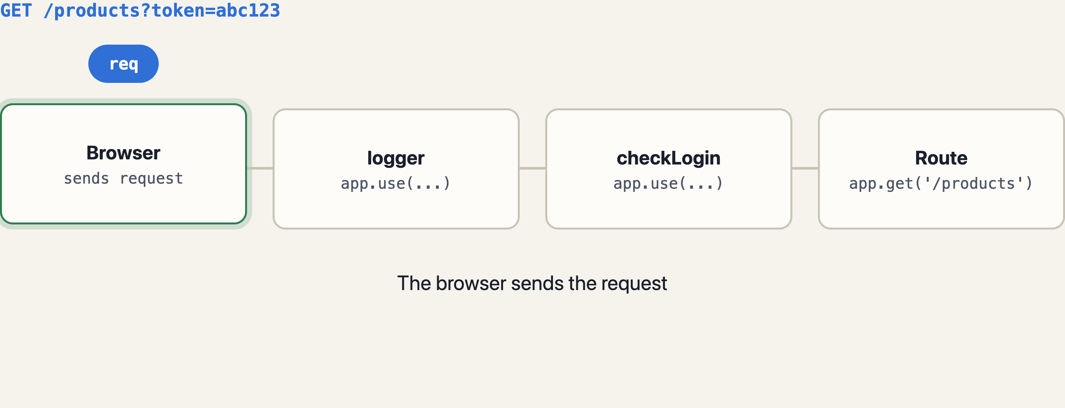
Each function passes the request on, or answers
WATCH IT RUN
Notes:
Two loops: with a token, the request walks through all three functions; without one, checkLogin ends the cycle and the route is never reached. This is exactly what middleware1 in the class code does when login is false.

Slide 52
Write it once, it runs for every request
STEP 1 · A LOGGER
server.js
YOU OPEN, IN ORDER
// the guide’s version:
// console.log('Time:', Date.now())
server.use((req, res, next) => {
const time = new Date().toISOString();
console.log(time, req.method, req.url);
next();
});
server.get('/products', (req, res) =>
res.json(products));
server.get('/products/:id', getOne);
// no path → runs for every request
/products
/products/5
/nope (404)
SERVER CONSOLE
2026-10-26T05:12:01.118Z GET /products
2026-10-26T05:12:05.430Z GET /products/5
2026-10-26T05:12:09.902Z GET /nope
Even /nope is logged: the logger runs before Express knows no route matches.
Notes:
The fix for the 40 copies starts here: one function registered with use() and no path. Toolkits like morgan (later) do exactly this, with nicer formatting.

Slide 53
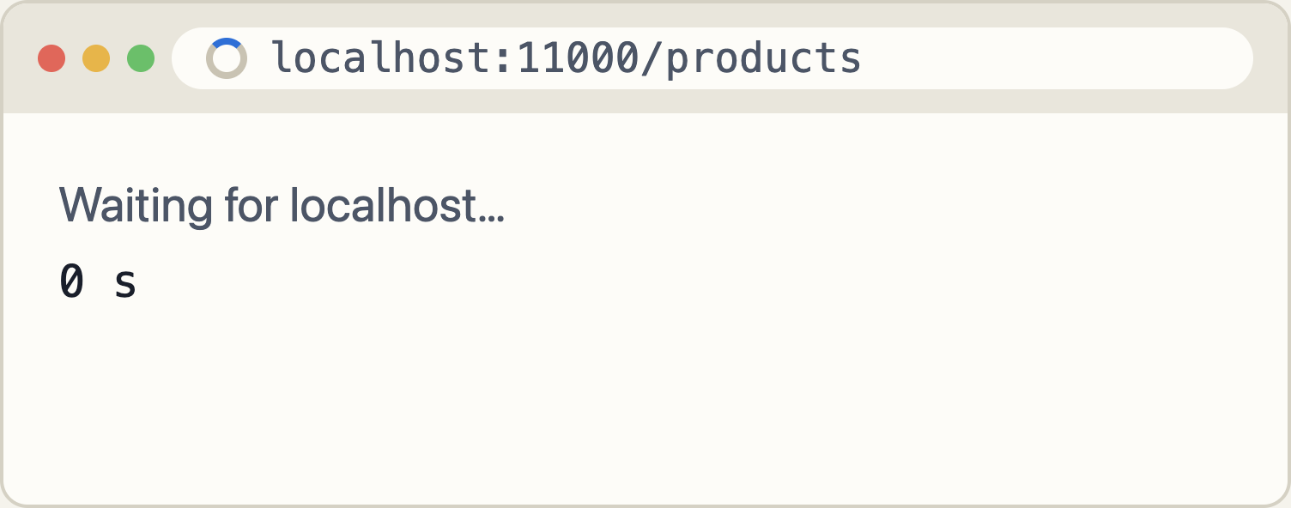
No next(), no answer: the browser waits forever
STEP 2 · FORGET NEXT()
server.js
server.use((req, res, next) => {
console.log(req.method, req.url);
// next(); ← forgotten
});
server.get('/products', (req, res) =>
res.json(products)); // never reached
// every middleware must do ONE of:
// next() → pass it on
// res.send(...) → answer it
SERVER CONSOLE
GET /products
No error, no crash. Just silence. That is what makes this bug hard to spot.
Notes:
Comment out next() live and reload: the tab spinner keeps going. There is no error message because nothing is technically wrong; the request is simply never answered. Rule: every middleware either calls next() or sends a response.

Slide 54
Registered after the route? Too late.
STEP 3 · ORDER MATTERS
server.js
YOU OPEN
server.get('/products', (req, res) =>
res.json(products));
// logger registered AFTER the route
server.use((req, res, next) => {
console.log(req.method, req.url);
next();
});
/products → list shown
/nope → 404
Express walks the list top to bottom and stops at the first function that answers.
SERVER CONSOLE
GET /nope
Rule: things that should run for everything go at the top. 404 and error handlers go at the bottom.
/products is missing: the route answered first. /nope reached the logger only because no route matched it.
Notes:
This is the most important rule in Express. Ask students to predict the console before revealing. The surprising part is that /nope does get logged, because Express only moves past a route when that route does not match.

Slide 55
Middleware can leave notes for the route
STEP 4 · ADD THINGS TO REQ
server.js
localhost:11000/products/3
server.use((req, res, next) => {
req.requestTime = Date.now();
next();
});
server.use('/products', (req, res, next) => {
res.locals.store = 'Fake Store';
next();
});
server.get('/products/:id', (req, res) => {
res.json({
title: findProduct(req.params.id).title,
store: res.locals.store,
tookMs: Date.now() - req.requestTime
});
});
{"title":"Mens Cotton Jacket",
"store":"Fake Store",
"tookMs":1}
YOU’VE SEEN THIS BEFORE
express.json() is a middleware that fills req.body.
cookie-parser fills req.cookies. An auth check can fill req.user.
Notes:
req and res are the same objects all the way down the chain, so anything one function attaches, the next can read. res.locals is the official place for per-request data meant for the response. This is the mechanism behind every body parser and auth library.

Slide 56
40 copies become 2 lines
STEP 5 · THE FIX · MIDDLEWARE1, DONE PROPERLY
server.js
BROWSER
const checkLogin = (req, res, next) => {
if (req.query.token === 'abc123') {
console.log("User has loggedIN......");
return next();
}
res.status(401).send("Kindly Login");
};
server.use(logger);
server.use(checkLogin);
server.get('/products', listAll);
server.get('/products/:id', getOne);
server.post('/products', addOne);
/products
401 · Kindly Login
/products?token=abc123
[{"id":1,"title":"Fjallraven…
SERVER CONSOLE
… GET /products
… GET /products?token=abc123
User has loggedIN......
Change the token rule once; every route follows.
Notes:
This is the class middleware1 with a real condition instead of var login = true. A token in the query string is fine for learning; real apps send it in a header such as Authorization. Ask: what if /products should be public but POST should stay protected? That question leads into mount paths and routers.

Slide 57
app.use(path, fn) runs only under that path
TYPE 1 · APPLICATION-LEVEL · WITH A MOUNT PATH
server.js · from the Express guide
DOES THE SECOND ONE RUN?
// no path: every request
server.use((req, res, next) => {
console.log('Time:', Date.now());
next();
});
// with a path: any METHOD on /products/:id
server.use('/products/:id', (req, res, next) => {
console.log('Request Type:', req.method);
next();
});
Request | Runs?
GET /products/5 | yes
DELETE /products/5 | yes
GET /products/5/reviews | yes (prefix)
GET /products | no
CONSOLE · DELETE /products/5
Time: 1793006021118
Request Type: DELETE
Notes:
These are the first two examples from the Express guide, renamed from /user/:id to /products/:id. app.use matches by prefix: anything that starts with /products/<something>. It ignores the HTTP method. Date.now() prints milliseconds since 1970, which is why the guide’s output is a big number.

Slide 58
Same path, very different reach
TYPE 1 · APP.USE VS APP.METHOD
Request | app.use('/products', fn) | app.get('/products', fn)
GET /products | runs | runs
POST /products | runs | no (GET only)
GET /products/5 | runs (prefix) | no (exact path)
GET /productsXYZ | no | no
usual job | prepare, then next() | answer the request
next('route') | not available | available
INSIDE app.use('/products', …) FOR GET /products/5
req.originalUrl '/products/5' req.baseUrl '/products' req.url '/5'
Notes:
The guide calls both "application-level" because both are bound to the app object. The difference: use() is a prefix match for every method, get/post/put/delete are exact matches for one method. The bottom box shows why req.url and req.originalUrl can differ: use() strips its mount path from req.url.

Slide 59
Several functions in one call, run left to right
TYPE 1 · MIDDLEWARE SUB-STACK
server.js · from the Express guide
localhost:11000/products/2?ref=ad
server.use(
'/products/:id',
(req, res, next) => { // 1st
console.log('Request URL:', req.originalUrl);
next();
},
(req, res, next) => { // 2nd
console.log('Request Type:', req.method);
next();
}
);
server.get('/products/:id', getOne); // 3rd
{"id":2,"title":"Mens Casual Premium Slim Fit T-Shirts ",…}
SERVER CONSOLE
Request URL: /products/2?ref=ad
Request Type: GET
Each next() hands over to the function to its right, then to the next registered one.
Notes:
A sub-stack is just a list of functions after the path. Express calls them in order; each must call next() for the following one to run. Product 2’s title really ends with a space in the API data.

Slide 60
Two routes for one path: the second never runs
TYPE 1 · MULTIPLE ROUTE HANDLERS
server.js · from the Express guide
localhost:11000/products/5
server.get(
'/products/:id',
(req, res, next) => {
console.log('ID:', req.params.id);
next();
},
(req, res) => {
res.send('Product Info'); // ends it
}
);
// same path, registered later
server.get('/products/:id', (req, res) => {
res.send(req.params.id); // never called
});
Product Info
Not “5”: the first route already answered.
SERVER CONSOLE
ID: 5
No error either. A duplicate route is silently dead code, so keep one route per path and method.
Notes:
The guide uses this to show that a route handler can also have a next parameter. Once something sends a response, the chain is over, and later matches are ignored. The next slide shows the one way to jump to that second route on purpose.

Slide 61
Skip the rest of this route, try the next one
TYPE 1 · NEXT('ROUTE')
server.js · from the Express guide
BROWSER
server.get(
'/products/:id',
(req, res, next) => {
if (req.params.id === '0') next('route');
else next();
},
(req, res) => {
res.send('regular');
}
);
server.get('/products/:id', (req, res) => {
res.send('special');
});
You open | You see
/products/5 | regular
/products/0 | special
next() → the next function in this route. next('route') → jump to the next matching route.
ONLY WORKS IN
app.get / post / put / delete and router.get / post / …, never in app.use().
Notes:
A realistic use: an id like "featured" or "0" that should be handled by a different route without an if-else ladder inside one handler. Note the comparison is with the string '0', because params are strings.

Slide 62
Name your middleware, group it, reuse it
TYPE 1 · REUSABLE MIDDLEWARE ARRAYS
server.js · from the Express guide
CONSOLE · DELETE /products/5?token=abc123
function logOriginalUrl(req, res, next) {
console.log('Request URL:', req.originalUrl);
next();
}
function logMethod(req, res, next) {
console.log('Request Type:', req.method);
next();
}
const logStuff = [logOriginalUrl, logMethod];
server.get('/products/:id', logStuff, getOne);
server.delete('/products/:id', logStuff, checkLogin, removeOne);
Request URL: /products/5?token=abc123
Request Type: DELETE
User has loggedIN......
WHY IT HELPS
Arrays and single functions can be mixed freely. Express flattens them into one chain, in the order written.
Notes:
Named functions are easier to read, test and reuse than inline arrows. The array is just a convenience; [a, b], c is the same chain as a, b, c. This is the last application-level pattern in the guide, and it sets up the idea of grouping, which is what Router does for whole sets of routes.

Slide 63
The store grows: public products, private admin
TYPE 2 · ROUTER-LEVEL · FIRST, WITHOUT ROUTER
app.js · everything in one file
app.get('/api/products', listAll);
app.get('/api/products/categories', listCategories);
app.get('/api/products/:id', getOne);
app.get('/api/admin/stats', checkAdmin, stats);
app.post('/api/admin/products', checkAdmin, addOne);
app.put('/api/admin/products/:id', checkAdmin, updateOne);
app.delete('/api/admin/products/:id', checkAdmin, removeOne);
// + orders, users, carts, reviews…
// app.js becomes a 300-line list
Prefix typed 7 times
Rename /api to /api/v2? Edit every line.
checkAdmin on each line
The next admin route someone adds may forget it.
No “admin” unit
You can move the handler functions to other files, but the paths and checks stay in app.js.
Notes:
This is the honest "before" picture. Ask: how would you put all admin routes in admin.js today? The usual workaround is module.exports = (app) => { app.get('/api/admin/…') }, which passes the whole app around and still hard-codes every full path. Also be fair: app.use('/api/admin', checkAdmin) would protect the group without Router. What it cannot do is make the group a portable unit.

Slide 64
Same code, app. swapped for router.
TYPE 2 · WHY THE GUIDE’S ROUTER EXAMPLE CONFUSES
Application-level (no Router)
Router-level (the guide’s version)
const app = express();
app.use((req, res, next) => {
console.log('Time:', Date.now());
next();
});
app.use('/user/:id', logUrl, logType);
app.get('/user/:id', checkZero, regular);
app.get('/user/:id', special);
const app = express();
const router = express.Router();
router.use((req, res, next) => {
console.log('Time:', Date.now());
next();
});
router.use('/user/:id', logUrl, logType);
router.get('/user/:id', checkZero, regular);
router.get('/user/:id', special);
app.use('/', router);
Identical output. Mounted at '/' in one file, Router adds nothing yet.
Its value shows up when you mount it at a prefix, move it to its own file, and give it its own middleware.
Notes:
This slide answers the "why are they writing Router directly" worry. The guide’s example only shows that router has the same use/get methods as app. The handler names are shortened versions of the guide’s inline functions. Next slide: the store from two slides ago, rewritten with Router, so the benefit is visible.

Slide 65
Each group becomes a mini-app in its own file
TYPE 2 · ROUTER-LEVEL · NOW WITH ROUTER
routes/products.js
routes/admin.js
const express = require('express');
const router = express.Router();
router.get('/', listAll);
router.get('/categories', listCategories);
router.get('/:id', getOne);
module.exports = router;
const router = require('express').Router();
router.use(checkAdmin); // once, for all
router.get('/stats', stats);
router.post('/products', addOne);
router.put('/products/:id', updateOne);
router.delete('/products/:id', removeOne);
module.exports = router;
app.js · the whole routing table
const products = require('./routes/products');
const admin = require('./routes/admin');
app.use('/api/products', products);
app.use('/api/admin', admin);
Prefix in one place. Paths inside are relative.
Check in one place. New admin routes are protected automatically.
No app passed around. Each file exports a unit.
Notes:
Same seven routes as two slides ago. Point at each fix: '/api/admin' appears once; checkAdmin appears once and covers every route added later; admin.js never sees app. Moving to /api/v2 is a one-line change in app.js, and the same router could even be mounted twice.

Slide 66
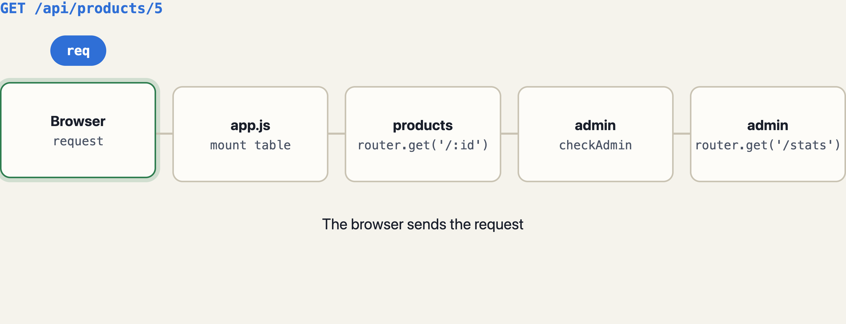
app.js picks the router; the router picks the route
WATCH IT ROUTE
Notes:
Three loops: a public product request goes only through the products router; an admin request without a token stops at checkAdmin; with the token it reaches the stats route. Note how the router only sees the part of the URL after its mount path.

Slide 67
checkAdmin guards admin, and only admin
TYPE 2 · ROUTER.USE() IS SCOPED
middleware/checkAdmin.js
BROWSER
function checkAdmin(req, res, next) {
if (req.query.token !== 'admin') {
return res.sendStatus(401);
}
console.log('baseUrl', req.baseUrl);
console.log('url ', req.url);
console.log('orig ', req.originalUrl);
next();
}
module.exports = checkAdmin;
You open | Result
/api/products | 200 list
/api/products/5 | 200 one
/api/admin/stats | Unauthorized
…/stats?token=admin | 200 stats
CONSOLE · LAST REQUEST
baseUrl /api/admin
url /stats?token=admin
orig /api/admin/stats?token=admin
Notes:
The products routes never pass through checkAdmin, because it is registered on the admin router, not on the app. The console shows how a router sees the URL: baseUrl is where it was mounted, url is the rest. The same function file can be reused on any other router that needs it.

Slide 68
Leave the whole router at once
TYPE 2 · NEXT('ROUTER')
With Router · from the Express guide
Same result, without Router
const router = express.Router();
router.use((req, res, next) => {
if (!req.headers['x-auth']) return next('router');
next();
});
router.get('/user/:id', (req, res) => {
res.send('hello, user!');
});
app.use('/admin', router, (req, res) => {
res.sendStatus(401); // anything that fell out
});
app.get('/admin/user/:id', (req, res) => {
if (!req.headers['x-auth']) {
return res.sendStatus(401);
}
res.send('hello, user!');
});
// fine for 1 route; repeat for 20?
TERMINAL
$ curl localhost:11000/admin/user/7
Unauthorized
$ curl -H "x-auth: 1" localhost:11000/admin/user/7
hello, user!
Notes:
next('router') skips every remaining function inside this router and continues after it in the app. Here the next thing after the router is the 401 handler in the same app.use call. The single-route version without Router is shorter, but the router version protects every route you add to it later.

Slide 69
Throw an error and Express answers for you
TYPE 3 · ERROR-HANDLING · THE PROBLEM
server.js · no error handler yet
localhost:11000/products/99
server.get('/products/:id', (req, res) => {
const p = findProduct(req.params.id);
if (!p) {
throw new Error('Product not found');
}
res.json(p);
});
// Express catches it and uses its own
// built-in error handler
Error: Product not found
at /home/you/store/server.js:14:11
at Layer.handle …
Status 500 · your file paths, shown to anyone
SERVER CONSOLE
Error: Product not found
at /home/you/store/server.js:14:11
at Layer.handle …
The server keeps running. The client just gets an ugly HTML page and the wrong status (should be 404).
Notes:
Good news first: the server did not crash; Express caught the throw. Bad news: the default page leaks the stack trace in development, sends HTML to an API client, and uses 500 for what is really a 404. With NODE_ENV=production it shows just "Internal Server Error". We want control over this.

Slide 70
Four arguments: (err, req, res, next)
TYPE 3 · YOUR OWN ERROR HANDLER
server.js
localhost:11000/products/99
server.get('/products/:id', (req, res, next) => {
const p = findProduct(req.params.id);
if (!p) {
const err = new Error('Product not found');
err.status = 404;
return next(err); // ← jump to the handler
}
res.json(p);
});
// LAST, after every route
server.use((err, req, res, next) => {
console.error('Handled:', err.message);
res.status(err.status || 500)
.json({ error: err.message });
});
{"error":"Product not found"}
Status 404 · clean JSON, no stack trace
SERVER CONSOLE
Handled: Product not found
Keep all four parameters, even if you never use next. Express counts them to know this is an error handler.
Notes:
next(err) with an argument means "something went wrong": Express skips every normal middleware and route and goes straight to the first function with four parameters. throw new Error inside a synchronous route does the same thing. The guide’s own example logs err.stack and sends 'Something broke!' with status 500.

Slide 71
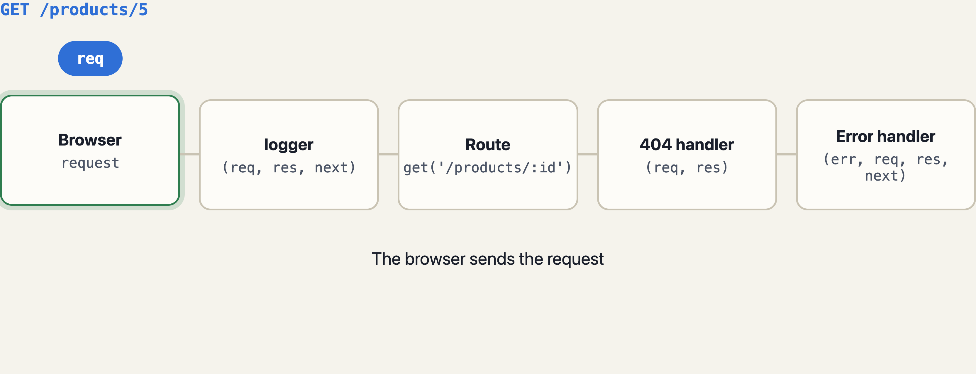
An error skips everything until a 4-argument function
WATCH ERRORS TRAVEL
Notes:
Three loops. A good request ends at the route. A bad id turns the request into an error that skips the 404 handler and lands in the error handler. An unknown path never errors; it falls through to the 404 handler. This is why the 404 handler and the error handler are two different functions.

Slide 72
Express 5 catches async errors for you
TYPE 3 · ASYNC ERRORS AND THE 404 HANDLER
server.js · end of the file
TRY IT: WI-FI OFF, OPEN /live/3
const API = 'https://fakestoreapi.com/products/';
server.get('/live/:id', async (req, res) => {
const r = await fetch(API + req.params.id);
res.json(await r.json());
}); // no try/catch needed in v5
// 404: normal middleware, near the end
server.use((req, res) => {
res.status(404).json({ error: 'Not found' });
});
// errors: 4 params, the very last
server.use((err, req, res, next) => {
console.error('Handled:', err.message);
res.status(err.status || 500)
.json({ error: err.message });
});
Handled: fetch failed
Browser: 500
{"error":"fetch failed"}
TWO TRAPS
(err, req, res) with 3 params is not an error handler. Errors pass straight by it.
Express 4 tutorials wrap every async route in try/catch + next(err). In v5 a rejected promise goes to the handler by itself.
Notes:
Demo idea: switch off Wi-Fi and open /live/3. fetch rejects, Express 5 forwards the rejection to the error handler, and the client gets clean JSON. Then compare the two final functions: the 404 one has two parameters and runs when nothing matched; the error one has four and runs only when something went wrong.

Slide 73
Two body readers, one for each kind of client
TYPE 4 · BUILT-IN · EXPRESS.JSON AND EXPRESS.URLENCODED
server.js
BROWSER · public/add.html
// JSON: fetch(), Thunder Client, Postman
server.use(express.json());
// HTML <form> posts
server.use(express.urlencoded({ extended: false }));
server.post('/products', (req, res) => {
const { title, price } = req.body;
console.log(title, price, typeof price);
res.send(`Added ${title}`);
});
Steel Bottle
12.5
Add
After clicking Add, the page shows:
Added Steel Bottle
SERVER CONSOLE
form: Steel Bottle 12.5 string
JSON: Steel Bottle 12.5 number
Forms always send text. JSON keeps numbers. Also built in: express.text() and express.raw().
Notes:
Show the HTML: <form method="POST" action="/products"> with inputs named title and price. Without express.urlencoded the form post arrives with req.body undefined, exactly like JSON without express.json. Each parser only reads its own Content-Type and ignores the rest, so having both is safe.

Slide 74
One line serves a whole folder
TYPE 4 · BUILT-IN · EXPRESS.STATIC
server.js · the class code, upgraded
WHAT EACH URL GETS
// const fs = require('fs');
// const data = fs.readFileSync(...);
// server.get('/', (req,res) => res.send(data));
const path = require('path');
server.use(express.static(
path.join(__dirname, 'public')
));
// store/
// server.js
// public/index.html style.css logo.png
URL | Answer
/ | public/index.html
/style.css | text/css file
/logo.png | image/png file
/products | no file: next() → route
No file found? It calls next(), so your routes still work. That is middleware behaviour.
Edit index.html, refresh: the change shows. No restart.
Notes:
This replaces three lines of the class code and fixes the restart problem from the start of the session. Using path.join(__dirname, 'public') means it works no matter which folder you run node from. The public folder name never appears in the URL.

Slide 75
npm install, require, app.use. Done.
TYPE 5 · THIRD-PARTY · COOKIE-PARSER (THE GUIDE’S EXAMPLE)
$ npm install cookie-parser
BROWSER, IN ORDER
const cookieParser = require('cookie-parser');
server.use(cookieParser()); // fills req.cookies
server.get('/theme/:name', (req, res) => {
res.cookie('theme', req.params.name);
res.send(`Theme set to ${req.params.name}`);
});
server.get('/products', (req, res) => {
console.log(req.cookies.theme);
res.json({
theme: req.cookies.theme || 'light',
count: products.length
});
});
/products
{"theme":"light","count":20}
/theme/dark → Theme set to dark
/products
{"theme":"dark","count":20}
SERVER CONSOLE
undefined
dark
Remove cookieParser() and req.cookies is undefined: the same story as req.body.
Notes:
The browser stores the cookie from Set-Cookie and sends it back on every later request; cookie-parser reads the Cookie header and turns it into the req.cookies object. Third-party middleware is still just (req, res, next) written by someone else and installed from npm.

Slide 76
Others already wrote the middleware you need
TYPE 5 · THIRD-PARTY · MORGAN AND CORS
Package | Adds
morgan | request logging
cors | cross-origin headers
cookie-parser | req.cookies
multer | file uploads (req.file)
express-session | login sessions (req.session)
compression | gzip responses
$ npm install morgan cors
const morgan = require('morgan');
const cors = require('cors');
server.use(morgan('dev')); // replaces our logger
server.use(cors()); // let other sites call us
SERVER CONSOLE · morgan('dev')
GET /products/5 200 2.871 ms - 453
GET /nope 404 0.904 ms - 21
GET /products/99 404 1.233 ms - 29
RESPONSE HEADER ADDED BY cors()
Access-Control-Allow-Origin: *
method · path · status · time · bytes sent
Without it, a React app on localhost:5173 calling your API on :11000 is blocked by the browser.
Notes:
morgan does what our hand-written logger did, with status and timing because it waits for the response to finish. cors matters as soon as a separate frontend calls this API. All of these are the same pattern: install, require, app.use (or router.use for just one group). The Express site keeps a list under Resources › Middleware.

Slide 77
All five types, in the order they must run
EVERYTHING TOGETHER · APP.JS
const express = require('express');
const morgan = require('morgan');
const products = require('./routes/products');
const admin = require('./routes/admin');
const app = express();
app.use(morgan('dev')); // 5 third-party
app.use(express.json()); // 4 built-in
app.use(express.static('public')); // 4 built-in
app.use((req, res, next) => { // 1 application-level
req.requestTime = Date.now(); next();
});
app.use('/api/products', products); // 2 router-level
app.use('/api/admin', admin); // 2 (checkAdmin inside)
app.use((req, res) => // 404: normal middleware
res.status(404).json({ error: 'Not found' }));
app.use((err, req, res, next) => // 3 error-handling
res.status(err.status || 500).json({ error: err.message }));
app.listen(11000);
1 · log every request
2 · read bodies, serve files
3 · stamp req for later
4 · hand to a router
5 · nothing matched → 404
6 · something broke → error
Notes:
Read it top to bottom as the path every request takes. Anything that should apply to everything is at the top; specific routes are in the middle; the safety nets (404, then errors) are at the very bottom. Click through the six steps on the right while pointing at the matching lines.

Slide 78
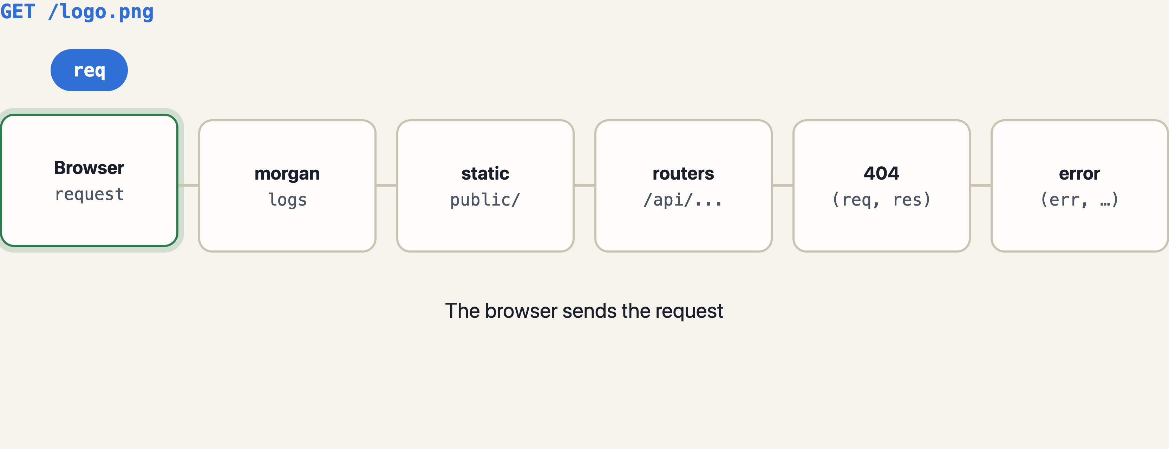
Each one stops at a different place
FOUR REQUESTS THROUGH THE FULL PIPELINE
Notes:
Four loops, four endings: a static file, a router, the error handler and the 404 handler. Ask students to call out where each request will stop before the packet gets there. If they can do that, they understand middleware.

Slide 79
Where it’s attached decides where it runs
CHEAT SHEET · THE FIVE TYPES
Type | Written as | Use it for
Application-level | app.use(fn), app.get(path, fn) | logging, auth or stamps for the whole app
Router-level | router.use(fn), router.get(…) | one feature under one prefix, in its own file
Error-handling | (err, req, res, next) => … | one place that formats every error
Built-in | express.json(), .urlencoded(), .static() | reading bodies, serving files
Third-party | npm i morgan → app.use(morgan('dev')) | logging, cors, cookies, uploads, sessions
next() or respond
Order = run order
4 params = error
404 is not an error
never neither, never both
general on top, safety nets last
keep next even if unused
it’s the last normal one
Notes:
The reference slide for the whole middleware part. The four rules at the bottom explain almost every bug students will hit in their first Express projects.

Slide 80
GET /products with this as the first middleware. What does the browser do?
QUIZ · MIDDLEWARE · 1 OF 7 · MCQ: ONE ANSWER
app.use((req, res, next) => {
console.log(req.method, req.url);
});
A Shows 404 Cannot GET
B Shows a 500 error
C Keeps loading, no answer
D Shows the products list
Answer: C
It neither calls next() nor sends a response, so the request is left hanging.
Notes:
The most common middleware bug. Students who say A or B expect Express to report something; it can’t, because nothing went wrong, nothing just happened.

Slide 81
Which function will Express use as an error handler?
QUIZ · MIDDLEWARE · 2 OF 7 · MCQ: ONE ANSWER
A (req, res, next) => …
B (err, req, res) => …
C (err, req, res, next) => …
D (error) => …
Answer: C
Express counts the parameters. Exactly four means “error handler”, even if next is never used.
Notes:
B is the trap from the error-handling section: with three parameters Express treats it as ordinary middleware whose first argument happens to be called err.

Slide 82
Which come built into Express, with no npm install?
QUIZ · MIDDLEWARE · 3 OF 7 · MSQ: CHOOSE ALL THAT APPLY
A express.json()
B cors()
C express.static()
D express.urlencoded()
E morgan('dev')
Answer: A, C, D
Built-ins hang off express itself. cors and morgan are third-party packages from npm.
Notes:
Quick rule: if it starts with express. it is built in (json, urlencoded, static, text, raw). Everything else came from npm install.

Slide 83
Given this line, which request does NOT run mw?
QUIZ · MIDDLEWARE · 4 OF 7 · MCQ: ONE ANSWER
app.use('/products', mw);
A GET /products
B POST /products
C GET /products/7/reviews
D GET /product
Answer: D
app.use matches any method and anything under /products. /product is a different path.
Notes:
C is the one students doubt: app.use is a prefix match by whole path segments, so /products/7/reviews runs it. B surprises those who think use means GET.

Slide 84
GET /products. Does the logger print anything?
QUIZ · MIDDLEWARE · 5 OF 7 · MCQ: ONE ANSWER
app.get('/products', (req, res) => res.json(products));
app.use(logger); // logs, then next()
A Yes, before the route runs
B Yes, after the route runs
C No, the route already answered
D It throws an error
Answer: C
Registration order is run order. The route ended the cycle, so Express never reached the logger.
Notes:
Follow-up: what about GET /nope? Then the route does not match, Express moves on, and the logger does print. Same lesson as the order slide.

Slide 85
Good reasons to use express.Router()?
QUIZ · MIDDLEWARE · 6 OF 7 · MSQ: CHOOSE ALL THAT APPLY
A Write a group’s prefix once, in app.js
B Attach middleware to just that group
C Move a feature to its own file without passing app
D It makes requests run faster
E next('route') only works with a router
Answer: A, B, C
Router is about organisation, not speed. next('route') also works with app.get / app.post.
Notes:
This question checks the main point of the router section. If students can explain A, B and C in their own words, they understand why the guide introduces Router.

Slide 86
Express 5, no try/catch. The fetch fails. What happens?
QUIZ · MIDDLEWARE · 7 OF 7 · MCQ: ONE ANSWER
app.get('/live/:id', async (req, res) => {
const r = await fetch(API + req.params.id);
res.json(await r.json());
});
A The whole server crashes
B The request hangs forever
C The error handler receives it
D Express sends 200 with no body
Answer: C
Express 5 forwards a rejected promise to the error handler, the same as next(err).
Notes:
In Express 4 the answer would have been closer to B (plus an unhandled rejection warning), which is why older code wraps every async route in try/catch.

Slide 87
req brings it in. res sends it out. Middleware sits between.
WHAT TO REMEMBER
req offers
res sends
middleware helps
params · query
body · cookies
headers · get()
method · path · ip
send · json
status().json()
sendStatus · sendFile
redirect · download
Write once, run everywhere: logging, login checks, body parsing, static files, 404s and errors.
next() or respond. Order matters. Router groups it.
URL parts are strings. Body and cookies need middleware.
Exactly once per request. Use return to stop early.
Notes:
Close by asking three students one question each: what can req tell you, what can res send, and why did we need middleware. If they can answer with the Fake Store examples, the session landed. Homework: finish sets 4 to 6 and move the admin routes into routes/admin.js with a Router.

